Slide 1
ECG AI ANALYSER AGENT

Slide 2
WHY ECG AI ANALYSER AGENT?
REDUCE TIME PRESSURE Cardiologists manually review each ECG which takes 5–10 minutes per report.
MISSED FINDINGS STEMI, AV blocks, and dangerous arrhythmias can be missed in busy wards and peak hours.
CLINICAL SUPPORT Accurate findings and no room for human errors.

Slide 3
ARCHITECTURE & WORKFLOW
1
UPLOAD
2
EXTRACT
PyMuPDF Converts to High-res PNG
3
Analyse
Gemini reads test and wave forms
Uploading ECG PDF
4
Range checks on all parameters
VALIDATE
5
DISPLAY
Findings and risk score shown

Slide 4
CLINICAL FINDINGS EXTRACTED
ECG Parameters
Clinical Findings
Heart Rate (bpm)
Sinus rhythm / arrhythmia
PR Interval (ms)
AV conduction status
QRS Duration (ms)
ST segment changes
QT / QTc Interval (ms)
Ventricular & atrial ectopics
Cardiac Axis
Atrial pause detection
OUTPUT → Risk Score (0–100) | Urgency Status: Normal / Needs Review / Urgent | Raw JSON for audit

Slide 5
TOOLS & PACKAGES
Streamlit
Google Gemini 2.5 Flash
Web interface & UI rendering
Vision AI — text extraction + waveform analysis
PyMuPDF
Pillow (PIL)
PDF to high-resolution PNG conversion
Image stitching & processing
Python
Streamlit Cloud
Core application logic & JSON validation
Deployment & secrets management

Slide 6
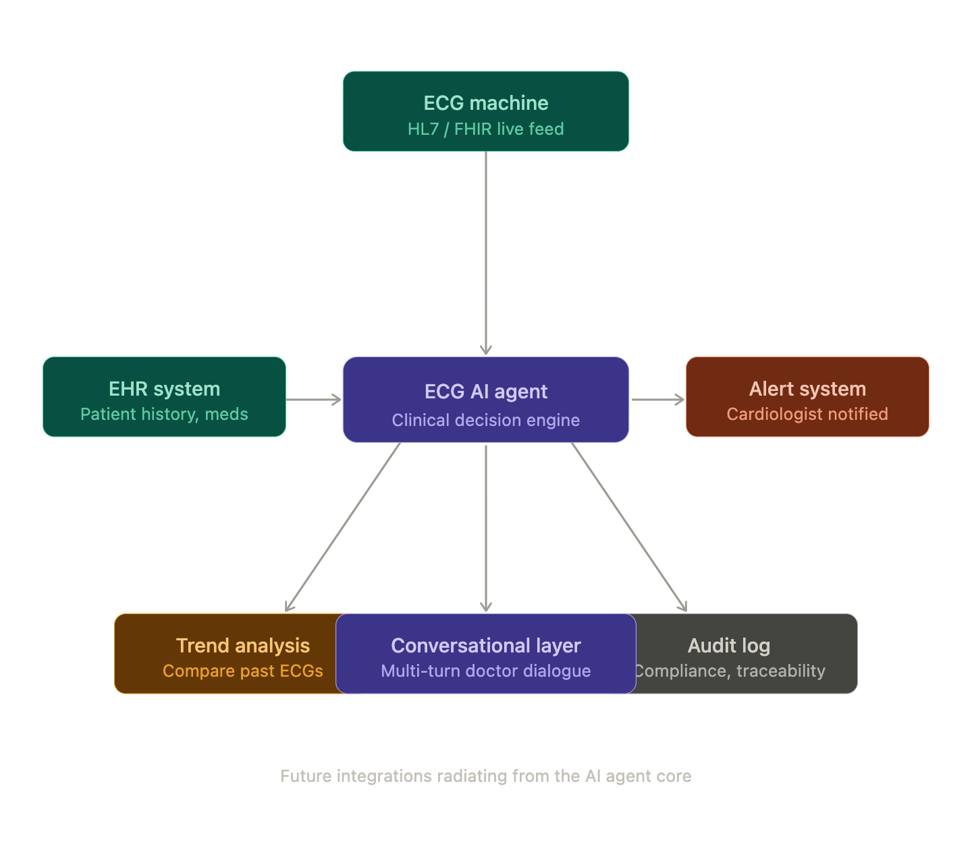
FUTURE SCOPE
FHIR API integration with hospital ECG machines
EHR connection for patient history cross-reference
Automated cardiologist alerting on STEMI detection
Multi-turn conversational agent for follow-up queries
Formula-based explainable risk scoring
Audit trail for clinical compliance

